Slide 1
Dia Dhuit

Slide 2
1. This movie actor became a courier for Sinn Féin leader Michael Collins.
a) George Brent b) Victor McLaglen
c) Barry Fitzgerald d) Tyrone Power

Slide 3
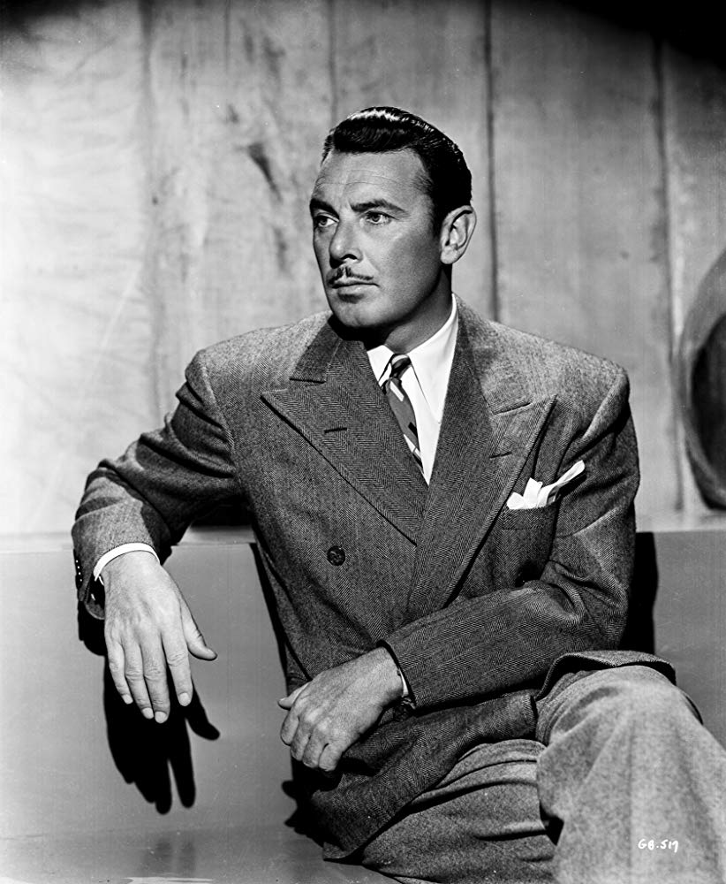
a) George Brent

Slide 4
2. This actor was an Irish nationalist, fought in the Easter Rising of 1916, was captured and held for six months in the Frongoch internment camp in Frongoch, Wales. He was decorated by the Republic of Éire. When he was cremated he given full military honors in Deans Grange Cemetery.
a) Frank Morgan b) Thomas Mitchell
c) Arthur Shields d) Pat O’Brien

Slide 5
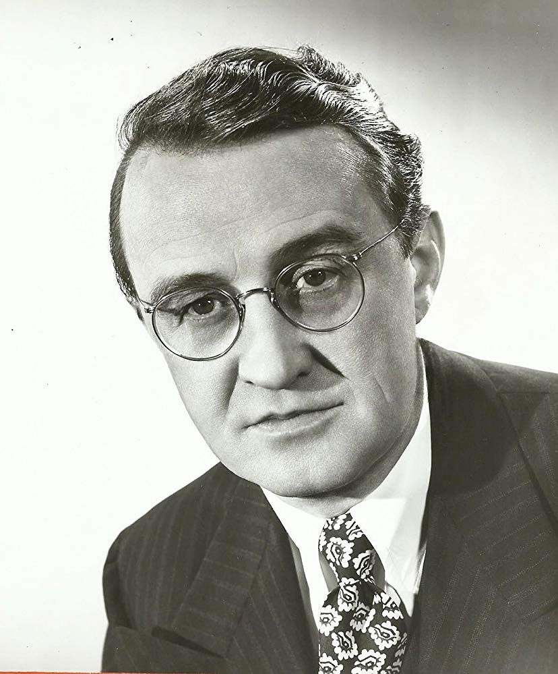
c) Arthur Shields

Slide 6
3. This actor’s name originally Lt. John Lowe was on leave from the army and visiting his parents when the Rising broke out. His father, General William Lowe, was commander of the British forces in Dublin, and the suddenness of the Rising saw his father co-opt him as a temporary aide-de-camp. He subsequently made movies in Hollywood. What is this actors stage name?

Slide 7
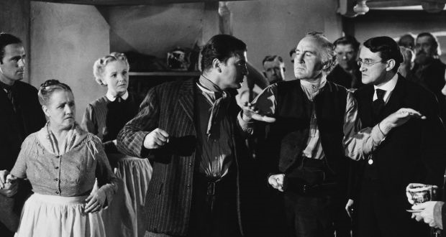
b) John Loder

Slide 8
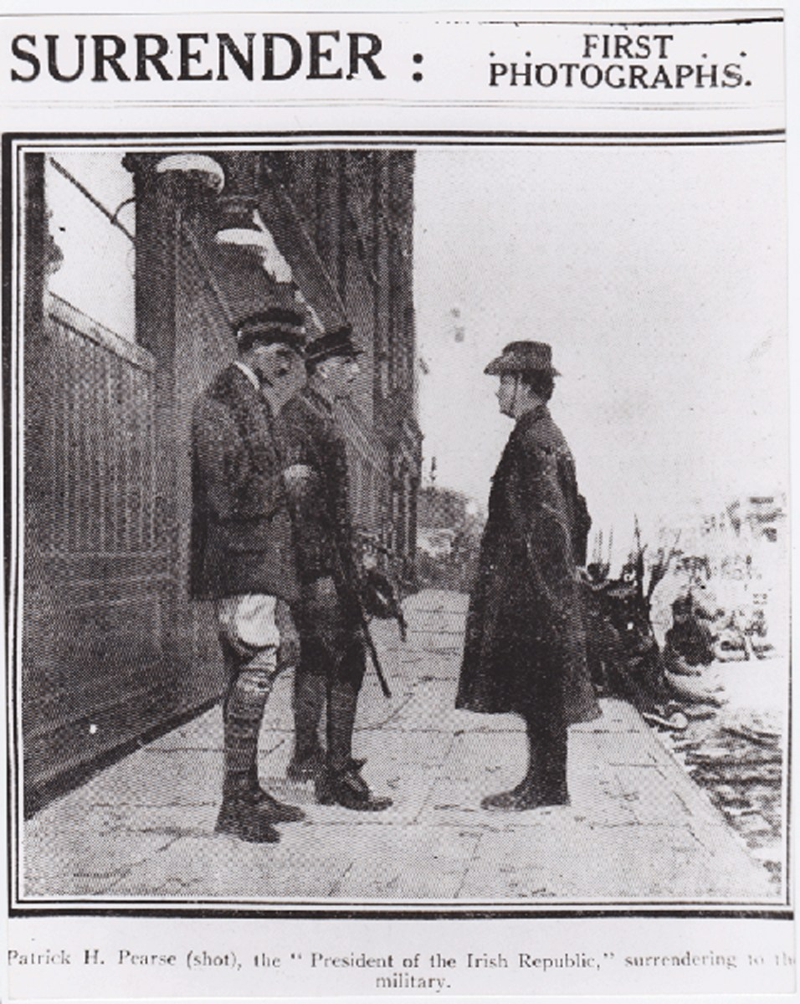

Slide 9
4. This actor was very proud being related to the Irish patriot Thomas Ashe, who died on a Hunger Strike in 1917 while being force fed.
a) John Huston b) Maureen O’Hara
c) Walter Brennan d) Gregory Peck

Slide 10
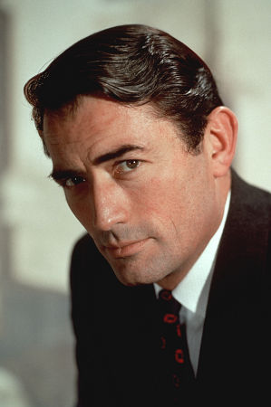
d) Gregory Peck

Slide 11
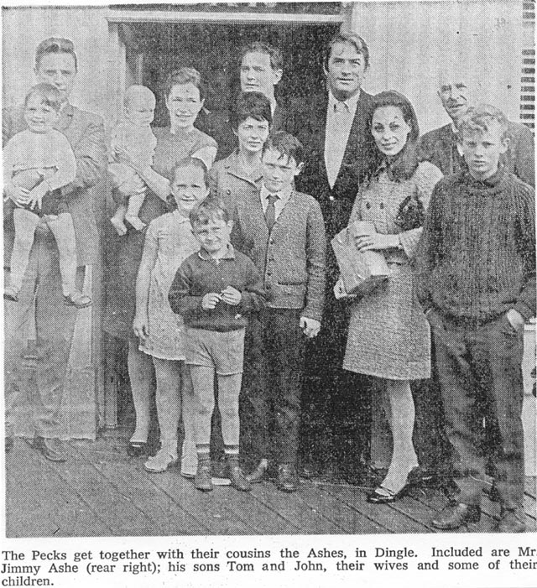

Slide 12
5. George M. Cohan, born in Providence, Rhode Island, was an avid baseball fan of which team?
a) Brooklyn Dodgers b) New York Giants
c) New York Yankees d) Boston Red Sox

Slide 13
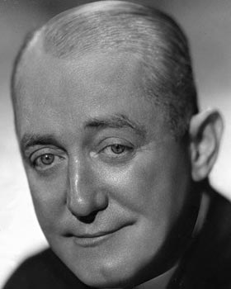
b) New York Giants

Slide 14
6. Irish writer, Liam O’Flaherty, was cousin to this famous movie person.
a) Pat O’Brien b) Maureen O’Hara
c) John Ford d) Tyrone Power

Slide 15
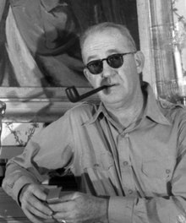
c) John Ford

Slide 16
7. What does the abbreviation RTÉ mean? ______________

Slide 17
Radio Television of Ireland

Slide 18
8. This Irish American pilot played himself in the movie ‘The Flying Irishman’.
a) Jimmy Stewart b) Douglas Corrigan
c) Brendan ‘Paddy’ Finucance d) Chuck Yeager

Slide 19
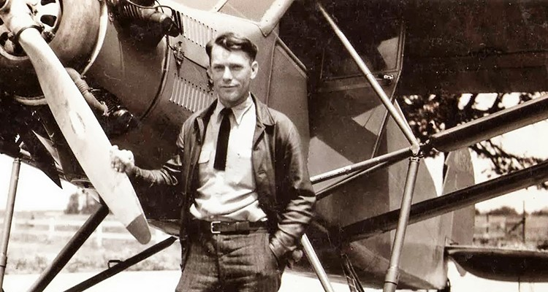
b) Douglas Corrigan

Slide 20
9. Who was the actor who invited Audie Murphy to come to Hollywood?
a) Clark Gable b) Gary Cooper
c) James Cagney d) John Wayne

Slide 21
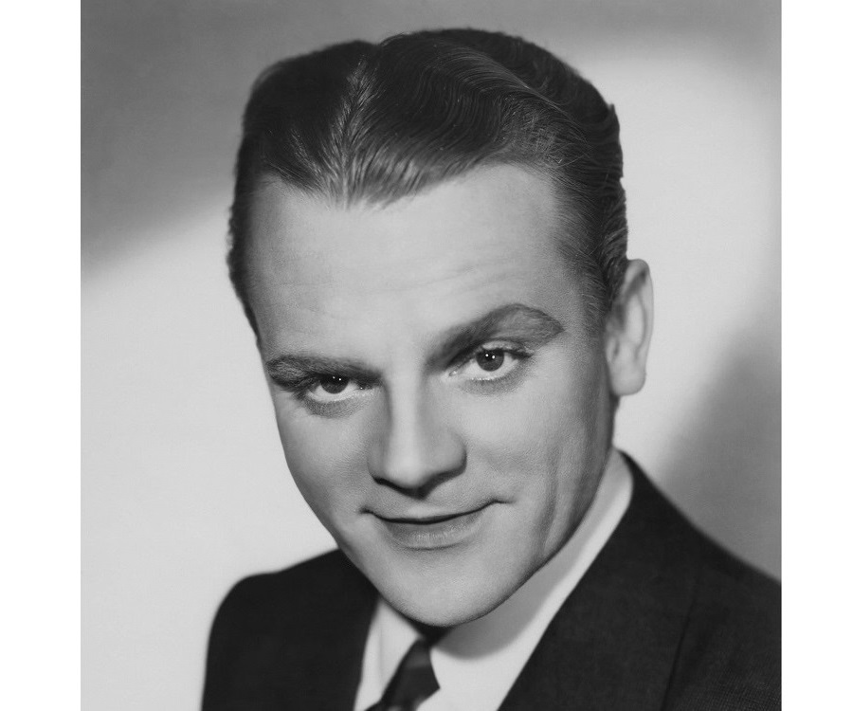
c) James Cagney

Slide 22
10. What was the name of the book, and later a movie, based on the life of Audie Murphy?
a) To Hell and Back b) Beyond Glory
c) No Guts, No Glory d) A Time for Dying

Slide 23
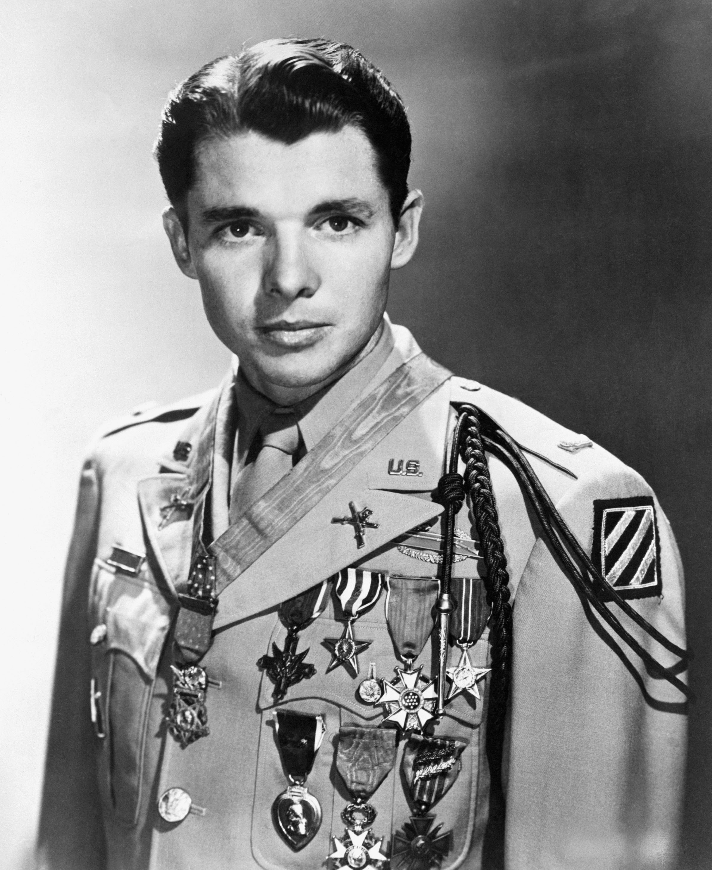
a) To Hell and Back

Slide 24
11. Who is the last person born in Ireland to win a competitive acting Oscar?
a) Daniel Day-Lewis b) Peter O’Toole
c) Liam Neeson d) Brenda Fricker

Slide 25
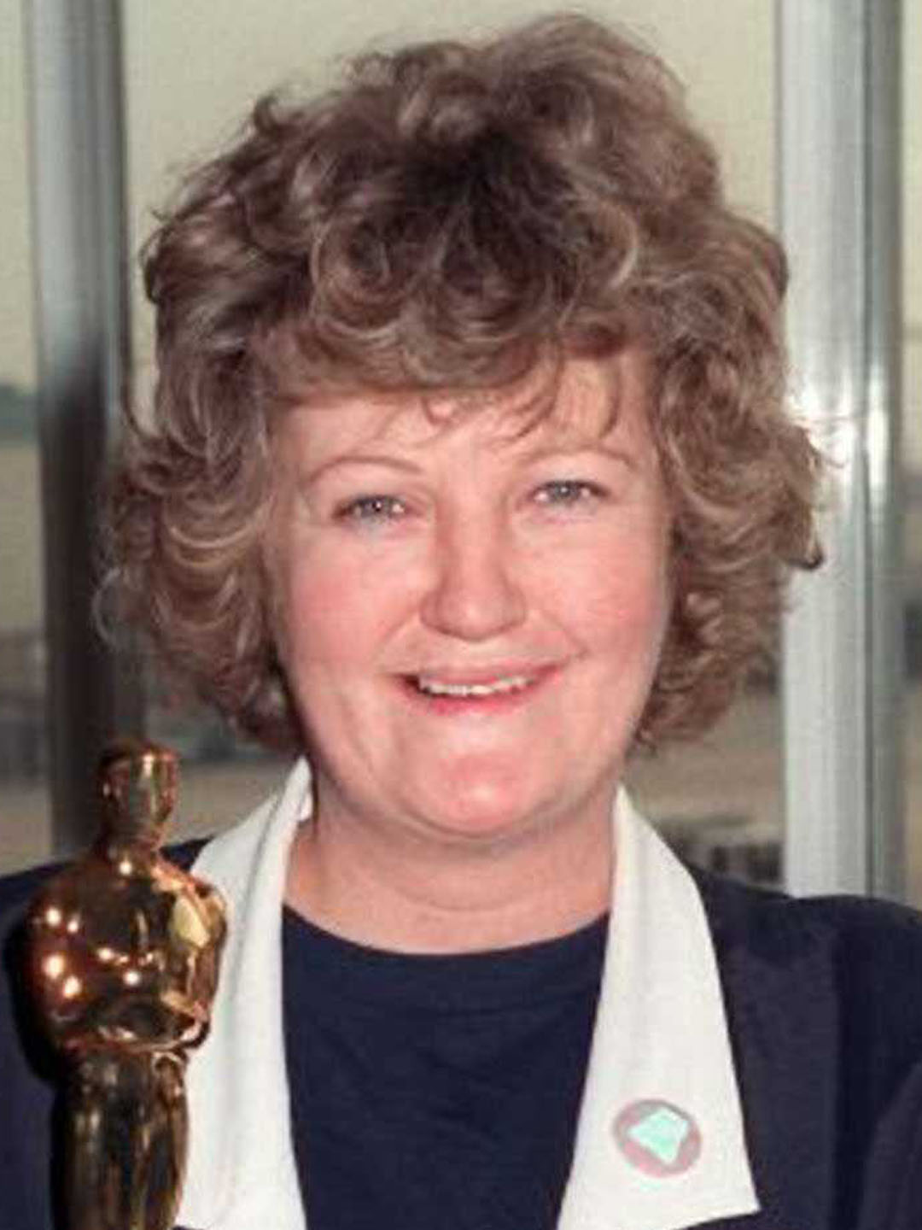
d) Brenda Fricker

Slide 26
12. The best way to describe the demeanor of the Cluricaun, who is a close cousin to the leprechaun, is
a) gloomy and industrious b) indolent and happy
c) compassionate and gullible d) considerate and materialistic

Slide 27
b) indolent and happy

Slide 28
13. The best way to describe the demeanor of a leprechaun is
a) diligent and moody b) agreeable and sullen
c) apathetic and cheery d) lazy and cheery

Slide 29
a) Diligent and moody

Slide 30
14. This Irish actor was nominated for both best actor and best supporting actor in the same movie?
Barry Fitzgerald
b) Victor McLaglen
c) John Wayne
d) Ward Bond
e) Tyrone Power

Slide 31
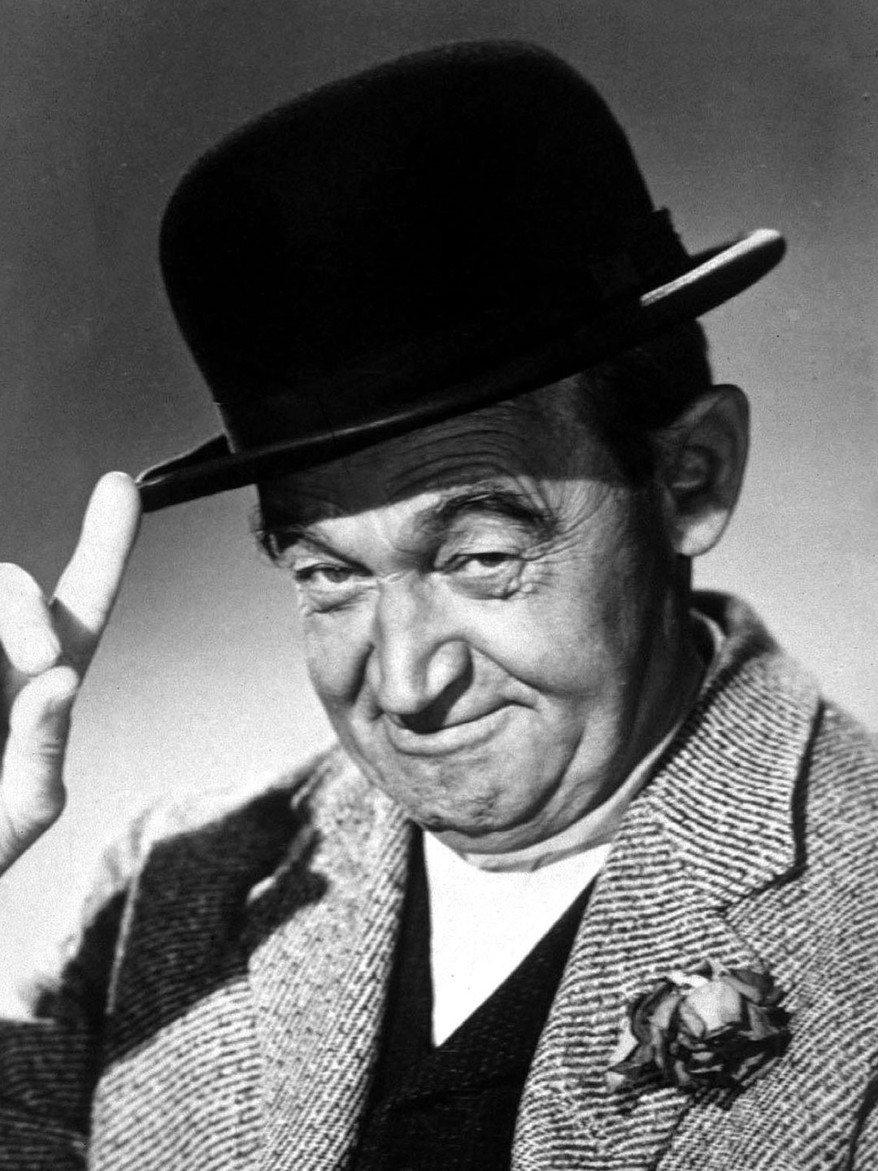
a) Barry Fitzgerald

Slide 32
15. For question 14, what was that movie?

Slide 33
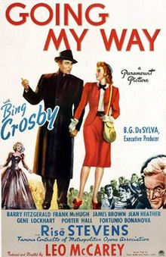

Slide 34
16. This Irish American is the most prolific movie Director of all time.
William Wyler b) Frank Capra
c) John Ford d) Clint Eastwood

Slide 35
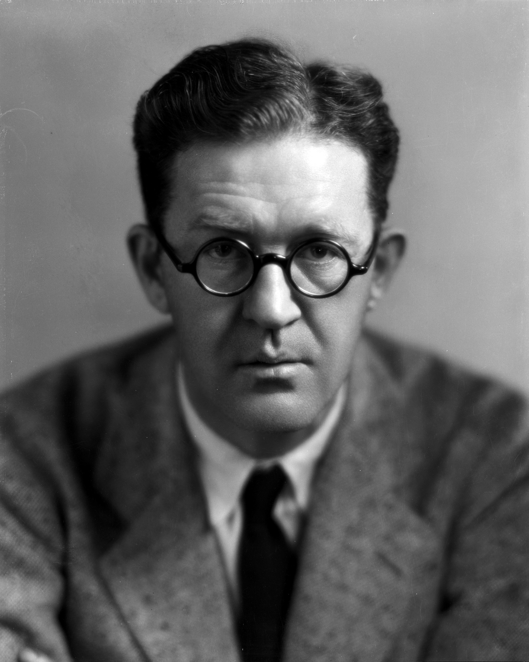
c) John Ford

Slide 36
17. The only actor to date to win three Oscars for Best Supporting Actor.
Maureen O’Hara b) Thomas Mitchell
c) Ward Bond d) Walter Brennan

Slide 37
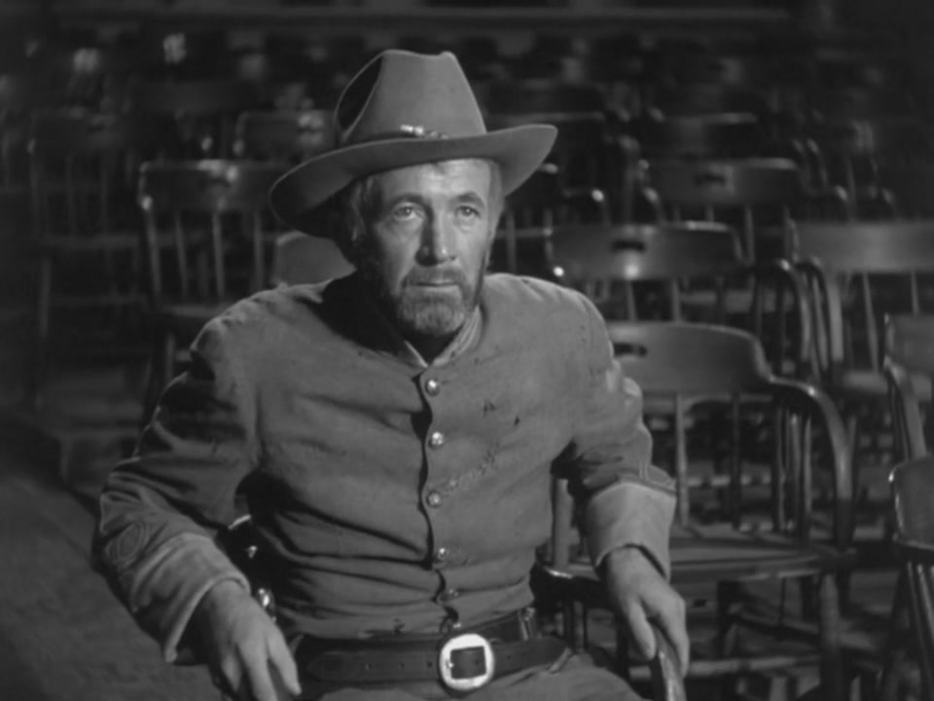
d) Wa

Slide 38
BONUS

Slide 39
Can you name two members and an American founding father that were born the same day as James H. Dooley on January 17?

Slide 40
Brian Hegarty
Patrick Knightly
Benjamin Franklin

