Slide 1
Father Edward Flanagan
A Saint For All Children

Slide 2
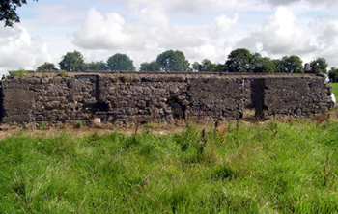
Flanagan’s Ireland Home

Slide 3
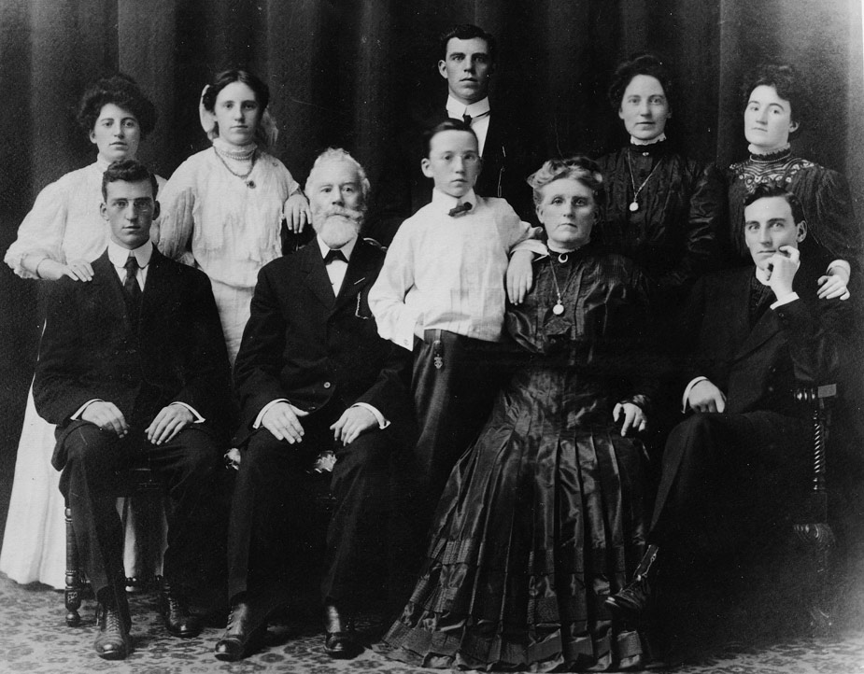

Slide 4
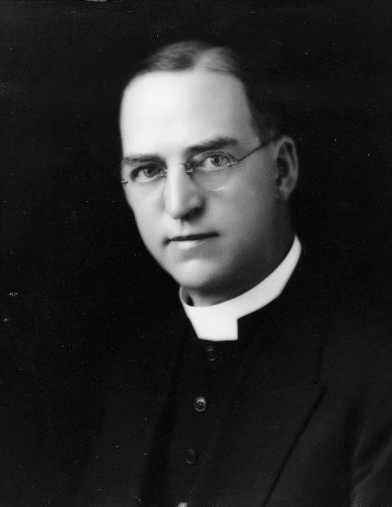

Slide 5
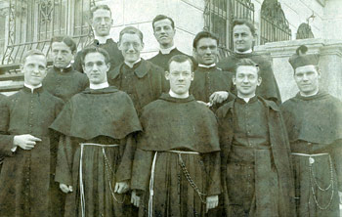
Flanagan in Seminary (first row second from left)

Slide 6
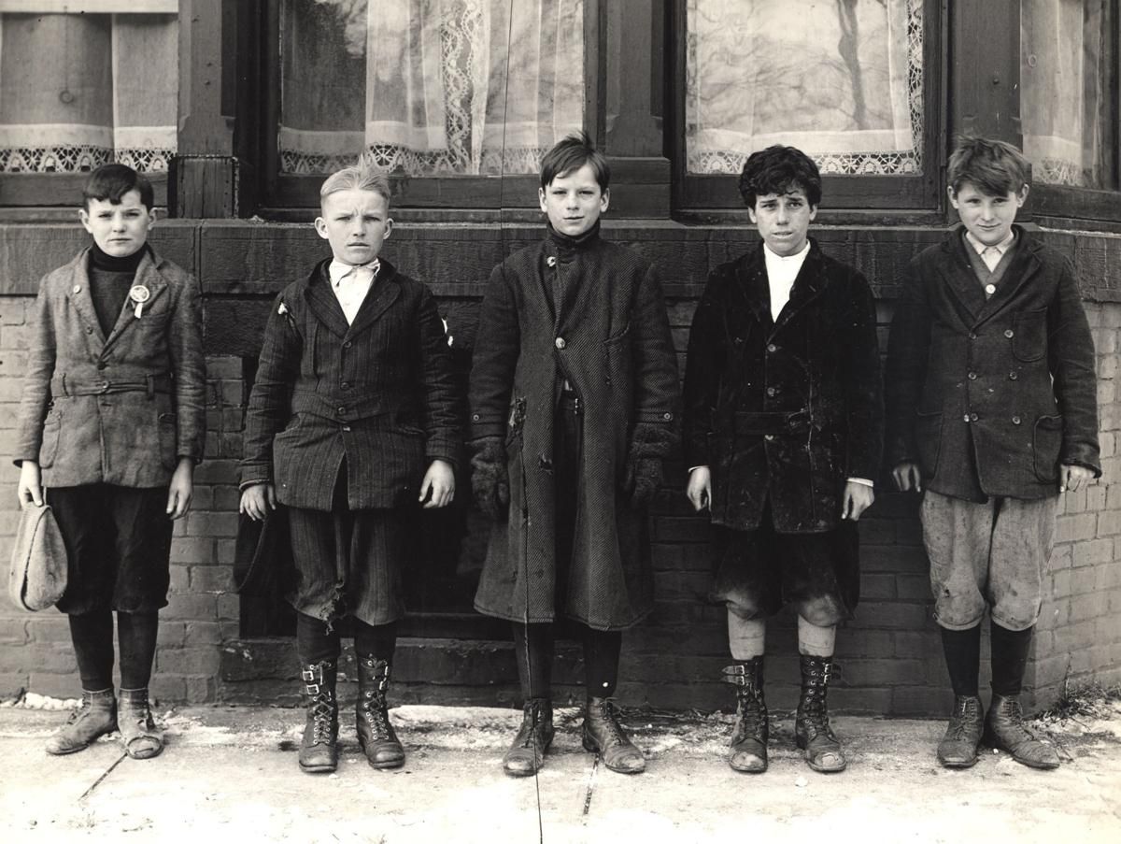
Father Flanagan’s First Five Boys

Slide 7
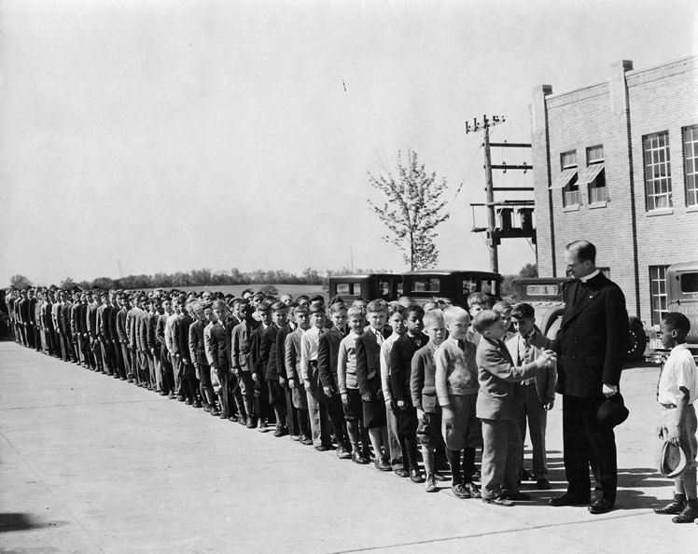
Fr. Flanagan with children

Slide 8
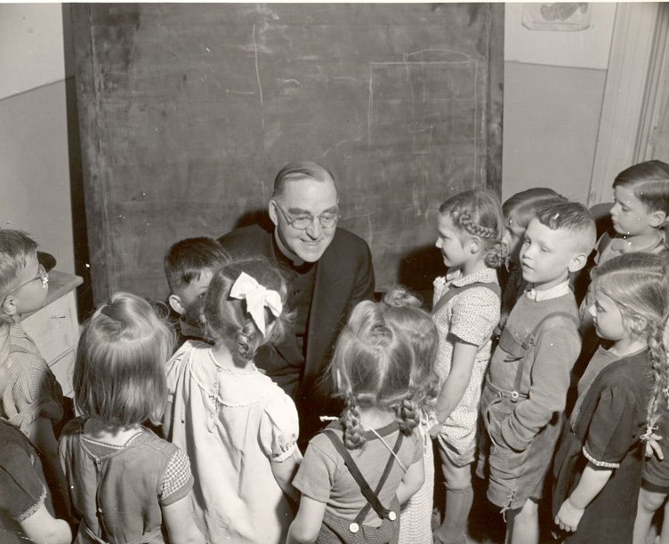
Fr. Flanagan with children

Slide 9
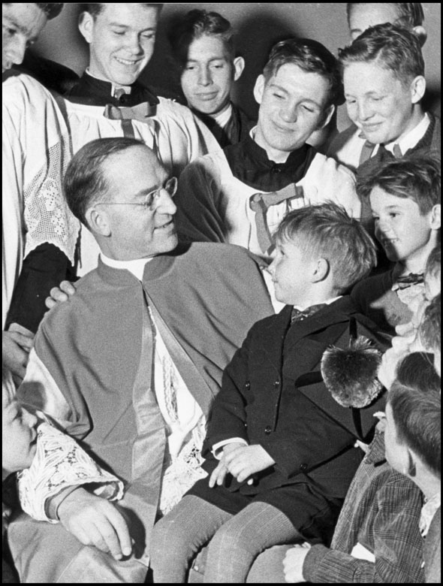
Fr. Flanagan with children

Slide 10
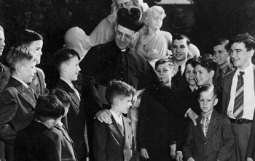
Monsignor Flanagan with children

Slide 11
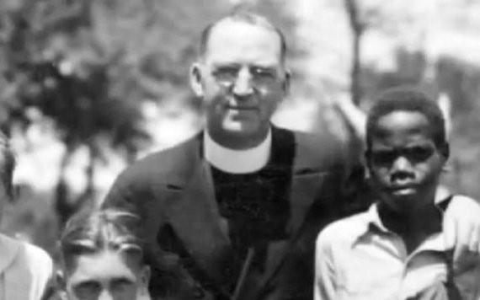
Fr. Flanagan with children

Slide 12
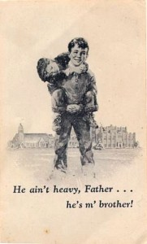

Slide 13
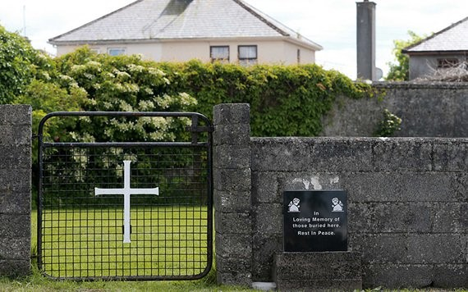
A Plaque dedicated to the 796 infants buried in mass grave at Tuam, Ireland

Slide 14
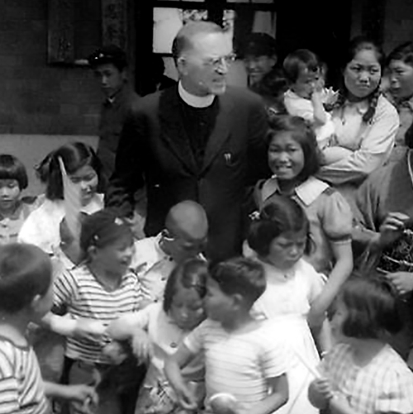
Father Flanagan with Japanese Children 1946

Slide 15
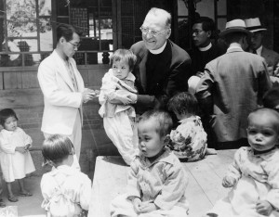
Fr. Flanagan in Japan

Slide 16
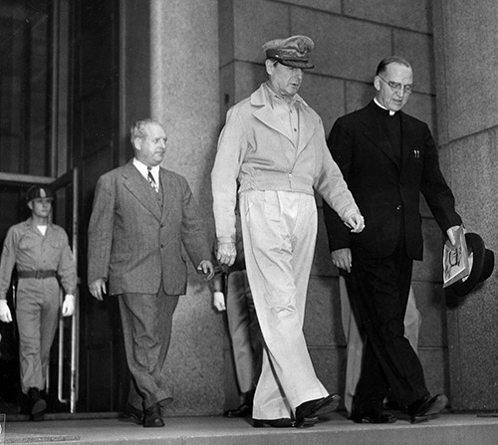
Father Flanagan and General MacArthur

Slide 17
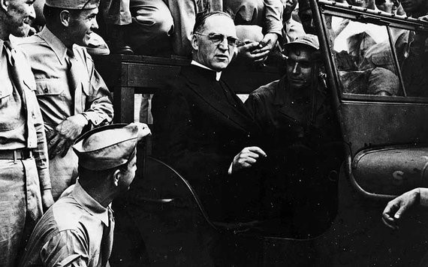
Father Flanagan and GIs

Slide 18
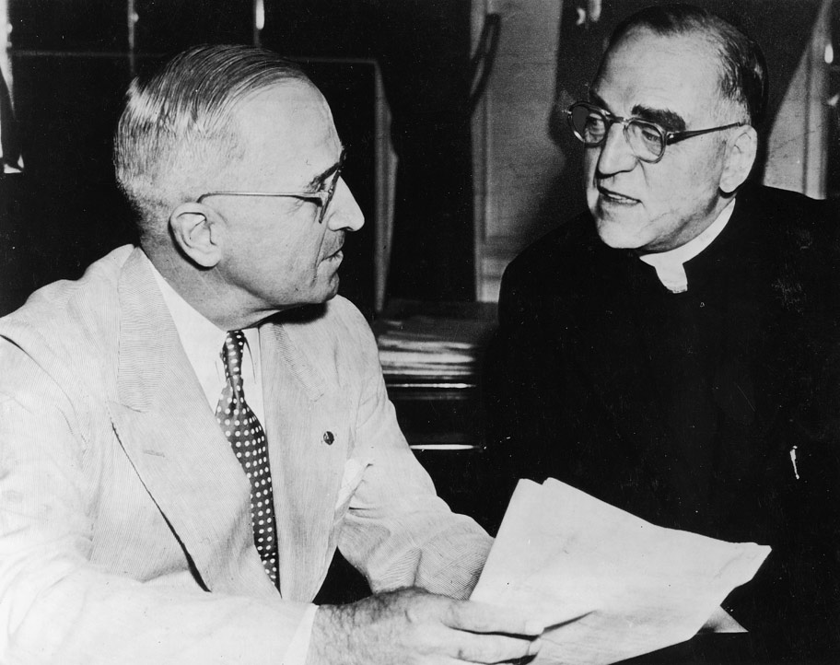
President Truman and Father Flanagan

Slide 19
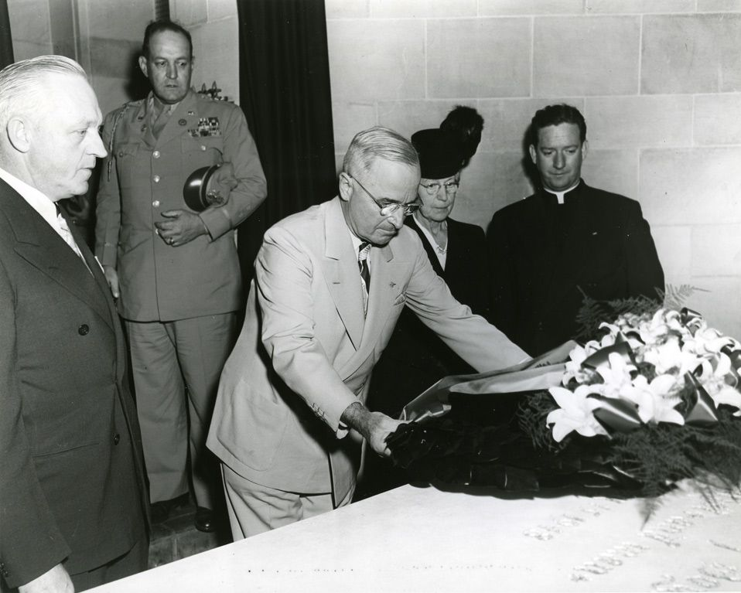
President Truman paying respects to Father Flanagan

Slide 20
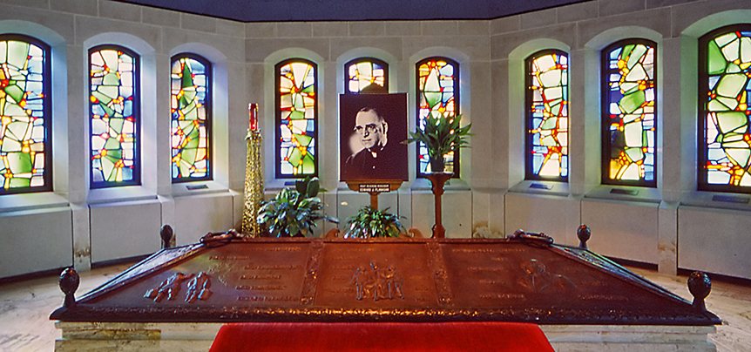
Father Flanagan Tomb

