Slide 1
Brig St. John
Tragic Cohasset Shipwreck

Slide 2
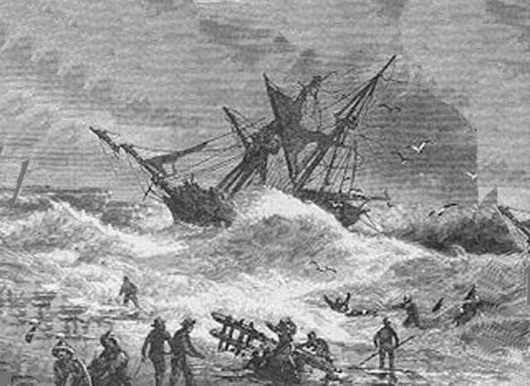
An illustration of the Brig St. John shipwreck of 1849

Slide 3
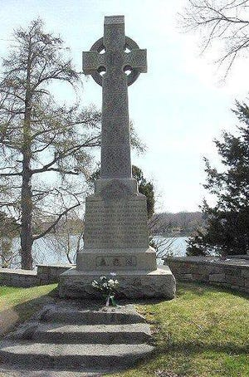

Slide 4
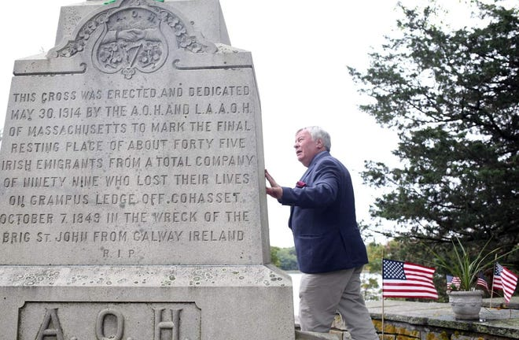

Slide 5
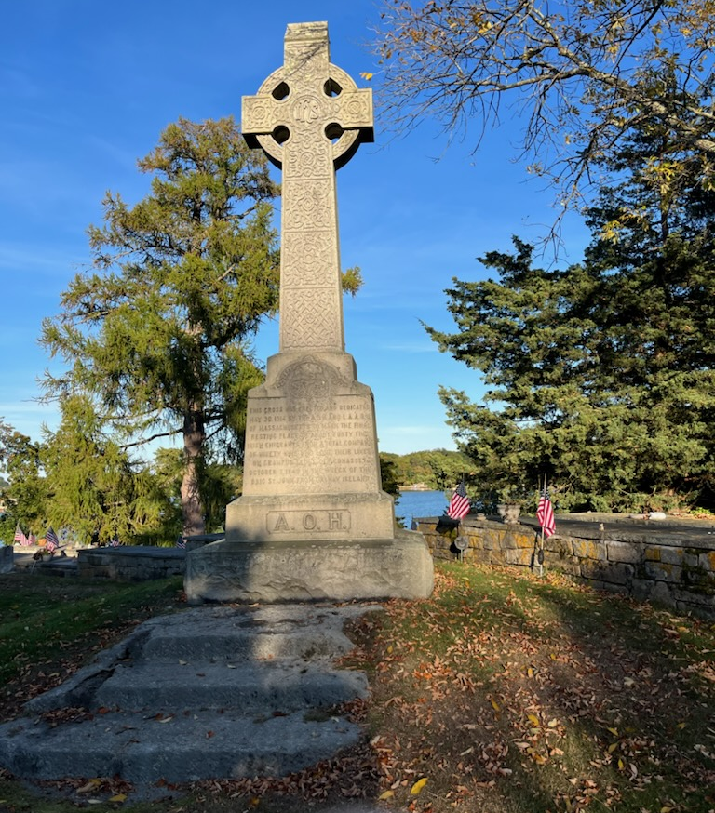

Slide 6
Brian Hegarty is ainm dom
Go raibh maith agaibh
(Plural, may you have goodness)
Slán Go Foill (Goodbye for now)

